Slide 1
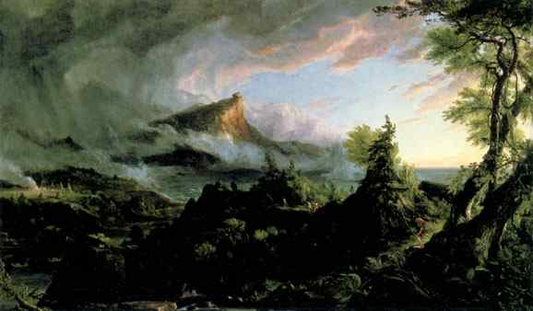
Transcendentalism

Slide 2
Anticipation Guide
For each statement, indicate whether you agree or
disagree and explain your reasons.
1. Spirituality is more important to me than worldly experience.
2. I am more concerned with this life than the next.
3. I see God in all things.
I believe rational thinking (thinking based on science and logic)
is more reliable than intuitive thinking (thinking based on emotion and perception).
5. I think society is usually wrong about most things.
6. I don’t think it is right to break any law – even an unjust law.

Slide 3
Vocabulary (in binder)
Philosophy (n)- Love and search of wisdom
Rational (adj)- having reason or understanding
Intuition (n) – feeling or “gut” instinct
Civil Disobedience- non violent refusal to obey authority

Slide 4
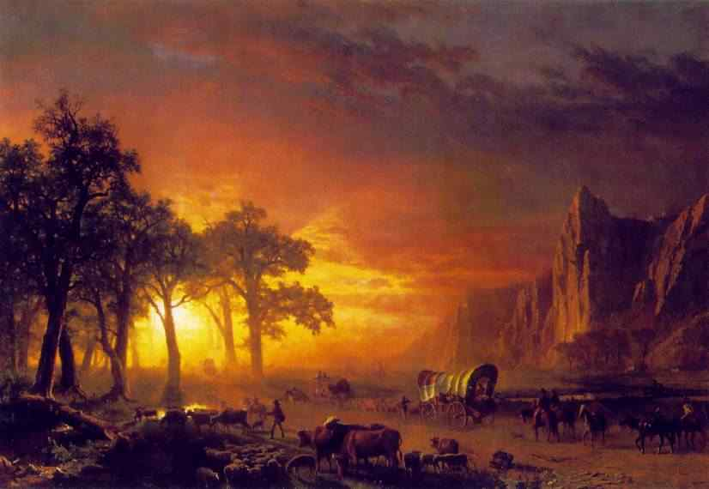
Transcendentalism
Transcendentalism is –
a major American literary movement
a philosophy- love and search for wisdom
a state of mind
a form of spirituality
It is NOT a religion; it can be applied to different faiths
Basic assumption: Intuition, rather than rationality, is the means for understanding the connection between yourself, the world, and God.

Slide 5
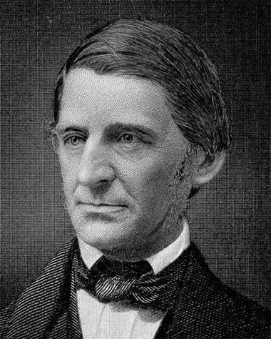
History
Transcendentalism is deeply rooted in American history:
inspired by the deep morality of the Puritans and Quakers
associated with Romanticism – an artistic movement that valued individuality, emotion, and nature over reason and society.
Most well-known transcendentalist writers:
Ralph Waldo Emerson
Henry David Thoreau
Margret Fuller

Slide 6
Basic Transcendentalist Ideas
The individual is the center of the universe
Individual happiness depends on self-realization
Every individual should be respected
God is within all of us
God is found in nature and human nature
There is a relationship between all things
Nature is symbolic - a living mystery full of signs
Miracles are all around us
People should not be more concerned with this life than the next
Death should not be feared
People should not be afraid to change their minds
People must be self-reliant and independent
The logic of society is often wrong

Slide 7
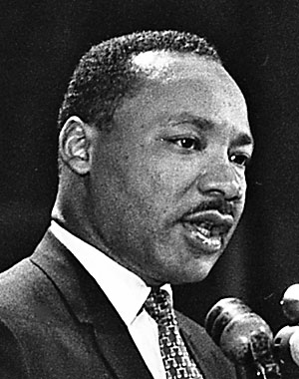
Legacy of Transcendentalism
Influenced American writers:
Edgar Allan Poe
Nathaniel Hawthorne
Herman Melville
Walt Whitman
Emily Dickinson
Henry David Thoreau
Ralph Waldo Emerson
Influenced the idea of civil disobedience
Gandhi
MLK
Influenced 1960s movements
Hippies
Anti-war movement
Black Power movement
Feminism

