Slide 1
William Shakespeare
The Bard
1564-1616

Slide 2
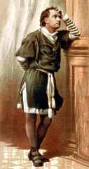
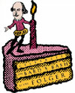
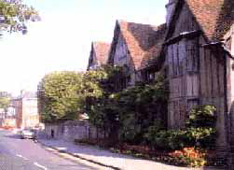
Childhood
Born April 23 (we think), 1564
Stratford-upon-Avon, England
Father was a local prominent merchant

Slide 3
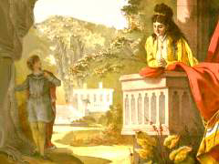
Family Life
Married Ann Hathaway 1582 (when he was 18, she was 26)
Three children: Susanna born in 1583, twins Judith and Hamnet born 1585
Hamnet died at age 11; the girls never had any children

Slide 4
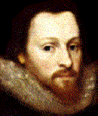
1585-1592
The Lost Years
We have no records of his life during this time period
It is speculated that he might have been a teacher, a butcher, or an actor to support his family.
In 1592, he is in London, while Ann and the kids are still in Stratford-upon-Avon

Slide 5
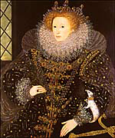
1590’s
Queen Elizabeth I ruled
English explorers were crossing the ocean to the New World
And travelers coming to England LOVED watching plays...

Slide 6
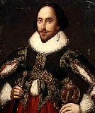
The Playwrights...
Christopher Marlowe
Thomas Kyd
William Shakespeare was the original “New Kid on the Block”

Slide 7
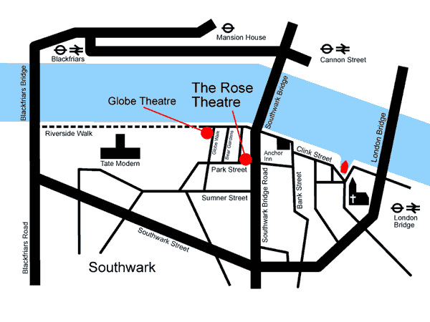
The Theatres...
The Theatre, built in 1576
The Rose, built in 1587 (London’s first “Bankside” theatre)
The Swan, 1595
The Globe (Shakespeare helped construct in 1598-1599)

Slide 8
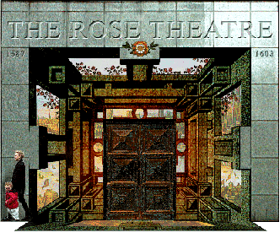
About the theatres
•Protestants condemned the plays
•Theatres were on the outskirts of London--away from the authorities
•People who attended the theatres included:
-merchants
-lawyers
-laborers
-prostitutes
-visitors from other countries
-nobility & royalty

Slide 9
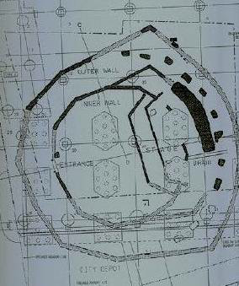
•No lighting
•No scenery--Just a curtain
•Could hold around 2,000 people

Slide 10
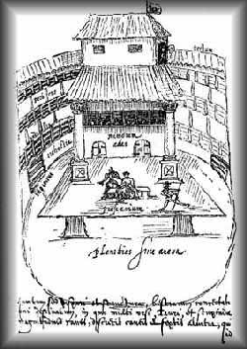
The most expensive seats were directly behind the stage, called the gallery.
Though the people sitting there could only see the actors from behind, they themselves could be seen by everyone in the audience.

Slide 11
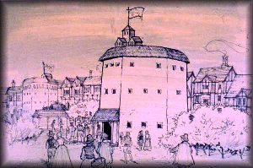
The theatres were closed during the plague.

Slide 12
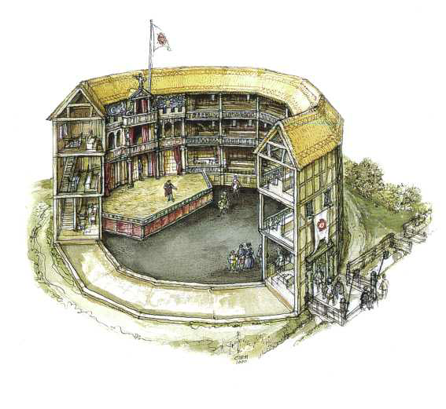

Slide 13
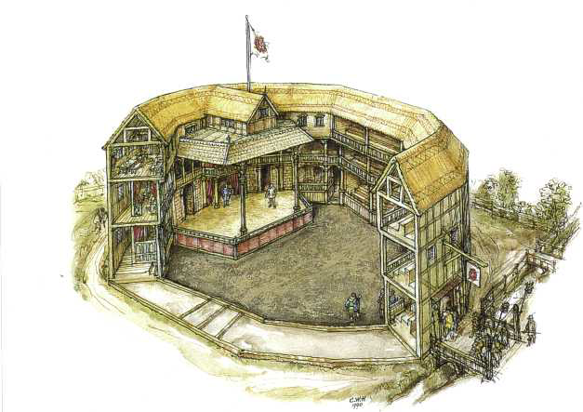

Slide 14
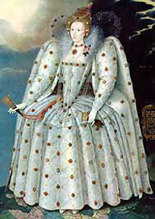
Costumes...
•Richly decorated
•Didn’t always match up to the time period of the play
•Looking good was more important than being realistic!

Slide 15
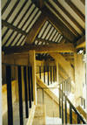
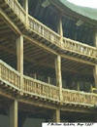
The Globe...
Where did they get the wood?
Can you guess which play was the first to be performed in The Globe?

Slide 16
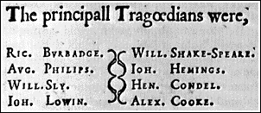
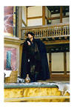

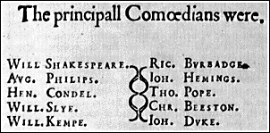


Slide 17
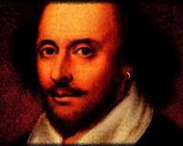
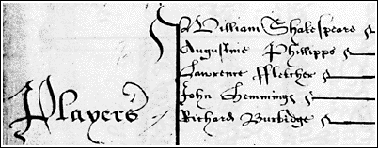
Who were the Players?
The Lord Admiral’s Men
The Lord Chamberlain’s Men (Shakespeare founded; Richard Burbage was their leading actor)
The Lord Chamberlain’s Men performed mostly in The Theatre

Slide 18
Acting
The actors were all men; young boys (age 12-14) played the female parts
They were considered “shareholders” and owned stock or shares in the play texts, costumes, and props
Their pay depended on admission sales
Actors only had about 3 weeks to practice a new play
In one week, the troupes may perform 6 different plays (as many as 4,000 lines!)

Slide 19
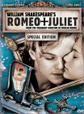
By 1597, Shakespeare...
Had written the following plays:
Romeo and Juliet
Merchant of Venice
A MidSummer Night’s Dream

Slide 20
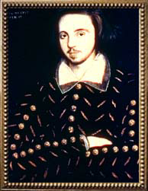
The Competition
Christopher Marlowe (1564-1593)
He was the first great playwright, paving the way for Shakespeare. He wrote and acted for The Lord Admiral’s Company--which was The Lord Chamberlain’s Men’s arch-rivals. He was possibly Shakespeare’s biggest influence.
Most Notable Works Include: Tamburlaine the Great (1587), Dr. Faustus (1588), The Jew of Malta (1589), Edward II (1592)

Slide 21
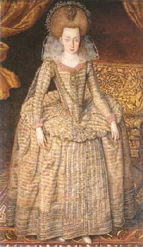
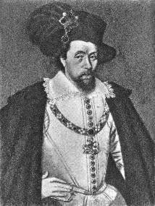
1603
Queen Elizabeth dies
Shakespeare’s troupe changes their name to The King’s Men, becoming the first OFFICIAL theatre company of England’s new king, James I

Slide 22
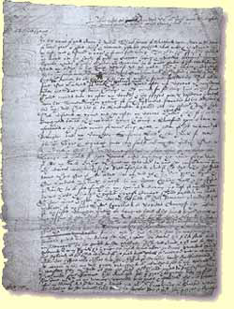
Shakespeare’s Last Days
Between 1611-1612, Shakespeare returns to Stratford to his wife and family.
Dies April 23, 1616 at the age of 53
His will, which he revised a month before dying, left the bulk of his estate to his oldest daughter, and the bed to his wife.

Slide 23
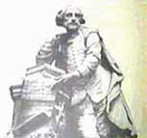
Shakespeare’s Epitaph…
"Good Friends, for Jesus' sake forbear,
To dig the bones enclosed here!
Blest be the man that spares these stones,
And curst be he that moves my bones."

Slide 24
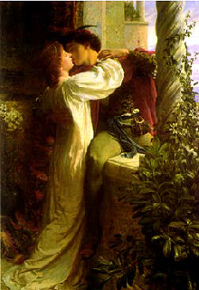
Love of the Language
In Shakespeare’s time, everyone loved the English language.
There were no grammar rules, punctuation keys, OR spelling!
The language was evolving and everyday new words were being made up.
Shakespeare’s language reflects this freedom and experimentation.

Slide 25
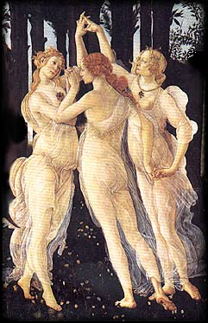
Iambic Pentameter
Is a sound pattern
IAMB: one unaccented (or unstressed) syllable with one accented syllable
It’s like a heartbeat: ba-bum, ba-bum, ba-bum
Five “ba-bum”s in a row make one line of iambic pentameter (10-syllable lines)
Example: he WENT to TOWN toDAY to BUY a CAR
OR: In SOOTH / I KNOW / not WHY / I AM / so SAD

Slide 26
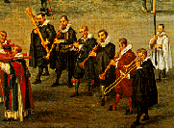
Why go to all the TROUBLE???
Using iambic pentameter kept things moving in the play (like a drum beat)
It made the words & play more interesting
It helped the actors remember their lines (like a song)

Slide 27
Where Did it Come From?
The Greeks and Romans started combining drama & poetry.
The English experimented with it, using verse and prose in their plays.
In the 1590s “Blank Verse” (poetry that doesn’t rhyme) was the new Craze!
The English Language is harder to rhyme than French or Italian, and English is more heavily accented.

Slide 28
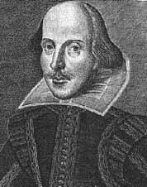
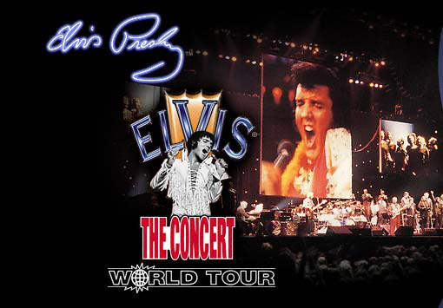
When Shakespeare set his words to iambic pentameter it is compared to the birth of
rock-n-roll:
a mixing of old styles and new sounds.

Slide 29
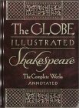

What would you do if you just lost your only copy of the paper you wrote?

Slide 30

•In Shakespeare’s time, you only had one copy of a play, and after you wrote it for the acting company, you no longer owned it!
•Scripts were thrown out when they were no longer wanted or needed.
•NO copies of Shakespeare’s plays in his own handwriting have survived. The only known evidence of anything in his handwriting is his signature (shown above) on the play Sir Thomas More that Shakespeare might have written.

Slide 31
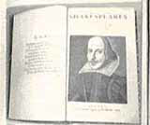
Companies may perform plays for years before they became printed.
Plays weren’t thought of as works of literature. They were “entertainment.”

Slide 32
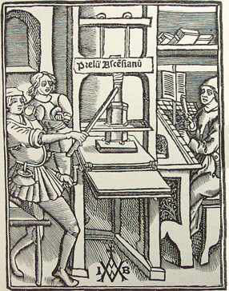
“Quartos”
Small books of published plays were called “quartos.”
The first published works of Shakespeare’s vary considerably, making it probable that they were written from actors’ memories, or shorthand notes from a scribe working for a publisher, as opposed to Shakespeare himself.
Scholars believe these are faulty versions, calling them “bad quartos.” Or as we say today, “Pirated” versions.

Slide 33
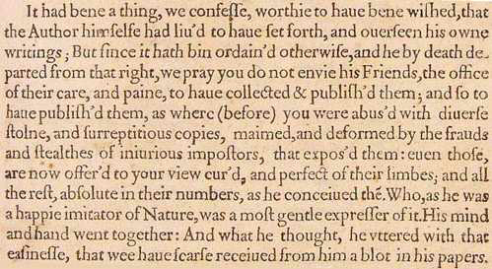
Plagiarism back then?
Acting troupes didn’t want other acting troupes stealing and performing their plays.
It was common that people would go watch the play and write down the lines they remembered, then sell the “quartos” to other acting troupes.
Many think that much of Shakespeare’s own work was stolen from other playwrights.
Remember, back then there were no copyright laws!
It says, in short:…because the author is dead, we are writing this for him...

Slide 34
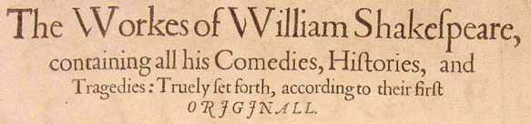
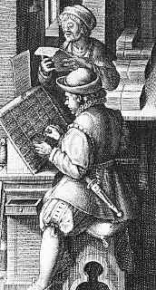
The first full collection of Shakespeare’s work was published in 1623, seven years after his death.
It was called “First Folio”
It contained 36 plays (compiled by John Heminge and Henry Condell--friends and fellow actors of Shakespeare’s)

Slide 35
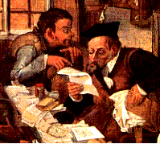
A Case of Bad Editing!
“First Folio”, as well as many other works at that time, contained many errors, due to the fact sometimes the printers could not read the handwriting and had to memorize the lines as they set them on the press.
The printers were the ones who decided how a line should be punctuated & spelled (not the writers)!

Slide 36
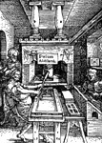
“First Folio” contained multiple errors--for example, there was no indication where Acts or Scenes began or ended.
Today’s Act and Scene divisions are based on shrewd “guesses” by generations of editors.
There are many uncertainties, so even today’s editions have variations in the text.

Slide 37
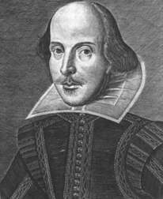
Why study Shakespeare?
Chances are, you’ve quoted Shakespeare without even knowing it!
Have you ever said the following...

Slide 38
“in a pickle”
“It’s Greek to me.”
“Too much of a good thing.”

Slide 39
“as luck would have it”
“good riddance”
“dead as a door-nail”
“foul play”

Slide 40
“a laughing stock”
“an eyesore”
“send me packing”
“without rhyme or reason”

Slide 41
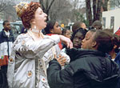
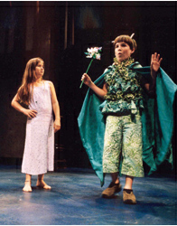
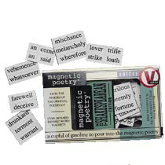

Even today, Shakespeare lives on.
We can relate to his tales of love, hatred, revenge, courage, trust and deception.
So much of our world today has been influenced by Shakespeare.

Slide 42
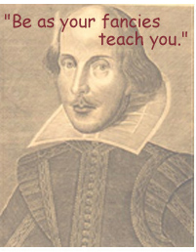
“All’s Well That Ends Well”
T. Orman, 2002-2003

Slide 43
Teacher’s Notes:
Slide 15:
• They got the wood from the dismantled “The Theatre.” Because of a problem with the lease, they took it apart (plank by plank), stored it, then built “The Globe” using the same wood.
• First play performed in the new Globe was The Tragedy of Julius Caesar

Slide 44
Answers to the “Shakespeare Questions/Notes” Handout
(Offered as a free download to go with this Powerpoint)
1. Shakespeare’s date of birth: April 23, 1564
2. Where was Shakespeare born? Stratford-Upon-Avon, England
3. How many children did Shakespeare have? 3 Names: Susanna, Judith, & Hamnet
4. Who was the ruler of England in the 1590’s? Queen Elizabeth I
5. Name two other playwrights: Christopher Marlowe & Thomas Kyd
6. What is the name of the first theatre built in London? The Theatre
7. What were the seats called behind the stage? The gallery
8. Were they cheaper or more expensive than the other seats? Most expensive
9. Which theatre was constructed from the wood of the theatre in question #6? The Globe
10. What was the name of Shakespeare’s acting troupe (either before or after they changed their name)? The Lord Chamberlain’s Men
11. What did the actors pay depend upon? The admission sales
12. Give three facts about Christopher Marlowe: first great playwright; wrote/acted for Lord Admiral’s Company; Shakespeare’s arch-rival; Shakespeare’s biggest influence; Notable works: Tamburlainethe Great, Dr. Faustus, The Jew of Malta, Edward II
13. Shakespeare’s date of death:
14. What is iambic pentameter? A sound pattern; IAMB is one unaccented syllable with one accented syllable.
15. How many syllables is in one line of iambic pentameter? 10
16. Why was iambic pentameter used? (Three reasons)Kept things moving (like a drum beat), made the words & play more interesting, helped actors remember their lines
17. What are “quartos”? Small books of published plays.
18. What was the name of the first printed complete work of Shakespeare’s? “First Folio”
19. Give one reason why many mistakes were made in these first printings: 1. Printers could not read the handwriting; 2. Printers had to memorize the lines as they set them on the press; 3. Printers decided how a line should be punctuated & spelled.
20. What was missing from that first edition (missing from the plays)? The divisions betweens Acts and Scenes were missing.
21. Write at least two sayings/phrases that Shakespeare created: (Any from the slides will do)
22. Why do we study Shakespeare today? We can relate to his themes of love, hatred, revenge, courage, trust, deception; our world has been greatly influenced by Shakespeare.

