Slide 1
Creating Your Resume

Slide 2
Objectives:
Students will describe the process of creating a resume.
Students will create a resume that creatively shows their skills and personality.
California Standards:
Proficient:
2.1 Solve a visual arts problem that involves the effective use of the elements of art and the principles of design.
2.3 Develop and refine skill in the manipulation of digital imagery (either still or video)
Advanced:
2.1 Create original works of art of increasing complexity and skill in a variety of media that reflect their feelings and points of view.
2.4 Demonstrate in their own works of art a personal style and an advanced proficiency in communicating an idea, theme, or emotion.
5.3 Prepare portfolios of their original works of art for a variety of purposes (e.g., review for post secondary application, exhibition, job application, and personal collection).

Slide 3
What is a Resume?
A resume is a personal summary of your professional history and qualifications.
This is the first document an employer will encounter from a job applicant.
Employers decide who they will interview by the quality of the resume.

Slide 4
Parts of a Resume
A resume generally includes the following sections:
Contact Information
Objective
Experience/Employment History
Skills
Education/Training
Awards
Affiliations

Slide 5
Contact Information
Employers need to know how to contact you so make it as easy as possible:
Your Name
Your Address
Your Phone Number (Home and Cell)
Your email

Slide 6
Jane Doe 1234 6th Street Merced, CA 95340 Cell (209)742-3456 Home (209) 888-4856 jdoe@smartcookie.com
Example of Resume
Note: Your resume should all fit on one page. Most employers will not want to read two pages worth of information.
Also, your font size should not be bigger than 12 pt and not smaller than 10 pt. You want people to be able to read your resume.

Slide 7
Objective
This is your job search mission statement.
It tells the prospective employer, in concise terms, the exact position you seek.
It should include a broad definition of the job title and a mention of the skills that would be utilized in this position.
You can and should tailor this to each employer you contact.

Slide 8
Objective
An objective should include two elements:
Your career, professional history or your major skills
and
a description of the job that you are seeking.
You could use this formula:
To obtain a position as a _________ allowing me to use my skills in ________.
Here are some examples:
To attain a job teaching art where I can help students to flourish in the arts field and build a contemporary digital arts program.
Creative and dedicated Graphic Designer seeking a full-time position with advancement opportunity to further enhance my knowledge in graphic design.
Obtain a position at ABC institute where I can maximize my training experience, program development skills and my teaching abilities.
Seeking a project management position with leadership responsibilities including problem solving, planning, organizing and managing budgets.
To secure a position that will lead to a lasting working relationship in the field of accounting or bookkeeping.
To obtain a position that will enable me to use my strong organizational skills, educational background and ability to work well with people.

Slide 9
Jane Doe 1234 6th Street Merced, CA 95340 Cell (209)742-3456 Home (209) 888-4856 jdoe@smartcookie.com
Example of Resume
Objective:
To attain a job teaching art where I can help students to flourish in the
arts field and build a contemporary digital arts program.

Slide 10
Experience/Employment
List any work experience, employment, or volunteer work that you have done.
Traditionally this is done in reverse chronological order, so you want your most recent job first.
For each job you want to tell the name of the company, address, dates you worked there and a brief description of your job duties.
REMEMBER: You are selling yourself and your skills.

Slide 11
Jane Doe 1234 6th Street Merced, CA 95340 Cell (209)742-3456 Home (209) 888-4856 jdoe@smartcookie.com
Example of Resume
Objective:
To attain a job teaching art where I can help students to flourish in the
arts field and build a contemporary digital arts program
Work Experience
Art Teacher - Merced Union High School District - Merced High School - 200 East Olive Avenue - Merced, CA 95348 - August 2008 to Current
Job Duties & Responsibilities:
- Teach Art 1, 3 , 4 and AP Studio Art
- Develop art and computer graphics curriculum based on California State Standards
- Coordinate major art exhibits for advanced students
Art Teacher/Language Arts Teacher- Merced City School District - Hoover Middle School - 800 East 26th Street - Merced, CA - (209) 385-6631- August 2003 to June 2008
Job Duties & Responsibilities:
- Developed art curriculum for 7th and 8th graders based on California State Standards
- Started and run an art club for 7th and 8th graders
Art Director - On Target Marketing/Image Masters - 429 Grogan Avenue n Merced, CA - (209) 723-1165
September 1988 to August 2003
Job Duties & Responsibilities:
- Designed logos, brochures, ads, billboards, web sites, posters, presentation folders, magazines, newsletters, newspapers, t-shirts and more
- Supervised and trained the graphic designers who worked with me
- Worked with the following computer programs: Adobe Illustrator, Quark Xpress, Adobe Photoshop, Adobe Pagemaker, Adobe GoLive, and Adobe Streamline

Slide 12
Education
Education
List the schools you have attended and the degrees you earned.
You also want to write your graduation date, GPA (if it’s higher than 3.0), and memberships in related honor societies.
If you have received any certifications or professional licenses you would also list those.
Again this is done in reverse chronological order, so list your most recent schooling first.

Slide 13
Jane Doe 1234 6th Street Merced, CA 95340 Cell (209)742-3456 Home (209) 888-4856 jdoe@smartcookie.com
Example of Resume
Objective:
To attain a job teaching art where I can help students to flourish in the
arts field and build a contemporary digital arts program
Work Experience
Art Teacher - Merced Union High School District - Merced High School - 200 East Olive Avenue - Merced, CA 95348 - August 2008 to Current
Job Duties & Responsibilities:
- Teach Art 1, 3 , 4 and AP Studio Art
- Develop art and computer graphics curriculum based on California State Standards
- Coordinate major art exhibits for advanced students
Art Teacher/Language Arts Teacher- Merced City School District - Hoover Middle School - 800 East 26th Street - Merced, CA - (209) 385-6631- August 2003 to June 2008
Job Duties & Responsibilities:
- Developed art curriculum for 7th and 8th graders based on California State Standards
- Started and run an art club for 7th and 8th graders
Art Director - On Target Marketing/Image Masters - 429 Grogan Avenue n Merced, CA - (209) 723-1165
September 1988 to August 2003
Job Duties & Responsibilities:
- Designed logos, brochures, ads, billboards, web sites, posters, presentation folders, magazines, newsletters, newspapers, t-shirts and more
- Supervised and trained the graphic designers who worked with me
Worked with the following computer programs: Adobe Illustrator, Quark Xpress, Adobe Photoshop, Adobe Pagemaker, Adobe GoLive, and Adobe Streamline
Education
Multiple Subjects CLAD Credential with supplementary authorization in Art
May 2003 - California State University Stanislaus - Turlock, California - Credential Program Grade Point Average 4.0
Currently pursuing a Administrative Credential and Masters in Education
Bachelors of Arts Degree in Art
December 1987 - California State University Long Beach - Long Beach, California

Slide 14
Skills
This is where you can list any special, job-related skills you may have. You can tailor this list to fit the needs of the position for which you're applying, or simply change the order of the list to present your most valuable skills first.
What computer programs do you know?
Are you familiar with both Mac and PC?
Are you bilingual?
What presentation equipment have you used?
NOTE: You can list your skills in a separate section or with each job in your work experience area. If you don’t have very much work experience it’s important that you list the skills you have.

Slide 15
Jane Doe 1234 6th Street Merced, CA 95340 Cell (209)742-3456 Home (209) 888-4856 jdoe@smartcookie.com
Example of Resume
Objective:
To attain a job teaching art where I can help students to flourish in the
arts field and build a contemporary digital arts program
Work Experience
Art Teacher - Merced Union High School District - Merced High School - 200 East Olive Avenue - Merced, CA 95348 - August 2008 to Current
Job Duties & Responsibilities:
- Teach Art 1, 3 , 4 and AP Studio Art
- Develop art and computer graphics curriculum based on California State Standards
- Coordinate major art exhibits for advanced students
Art Teacher/Language Arts Teacher- Merced City School District - Hoover Middle School - 800 East 26th Street - Merced, CA - (209) 385-6631- August 2003 to June 2008
Job Duties & Responsibilities:
- Developed art curriculum for 7th and 8th graders based on California State Standards
- Started and run an art club for 7th and 8th graders
Art Director - On Target Marketing/Image Masters - 429 Grogan Avenue n Merced, CA - (209) 723-1165
September 1988 to August 2003
Job Duties & Responsibilities:
- Designed logos, brochures, ads, billboards, web sites, posters, presentation folders, magazines, newsletters, newspapers, t-shirts and more
- Supervised and trained the graphic designers who worked with me
Worked with the following computer programs: Adobe Illustrator, Quark Xpress, Adobe Photoshop, Adobe Pagemaker, Adobe GoLive, and Adobe Streamline
Education
Multiple Subjects CLAD Credential with supplementary authorization in Art
May 2003 - California State University Stanislaus - Turlock, California - Credential Program Grade Point Average 4.0
Currently pursuing a Administrative Credential and Masters in Education
Bachelors of Arts Degree in Art
December 1987 - California State University Long Beach - Long Beach, California
You can see that I’ve added my skills under each of my jobs in the work experience section. You can do it this way or list them separately.

Slide 16
Awards & Associations
When others recognize your efforts, it says a lot about you and your work. Awards can be both personal and professional, and should be listed in reverse chronological order.
Being a member of a professional association speaks volumes about your interest in your field, and can be an instant conversation starter. The same goes for affiliations with non-profit organizations. If you're a volunteer for a local food pantry, or a member of the Ad Association, chances are your interviewer is, too.

Slide 17
Jane Doe 1234 6th Street Merced, CA 95340 Cell (209)742-3456 Home (209) 888-4856 jdoe@smartcookie.com
Example of Resume
Objective:
To attain a job teaching art where I can help students to flourish in the
arts field and build a contemporary digital arts program
Work Experience
Art Teacher - Merced Union High School District - Merced High School - 200 East Olive Avenue - Merced, CA 95348 - August 2008 to Current
Job Duties & Responsibilities:
- Teach Art 1, 3 , 4 and AP Studio Art
- Develop art and computer graphics curriculum based on California State Standards
- Coordinate major art exhibits for advanced students
Art Teacher/Language Arts Teacher- Merced City School District - Hoover Middle School - 800 East 26th Street - Merced, CA - (209) 385-6631- August 2003 to June 2008
Job Duties & Responsibilities:
- Developed art curriculum for 7th and 8th graders based on California State Standards
- Started and run an art club for 7th and 8th graders
Art Director - On Target Marketing/Image Masters - 429 Grogan Avenue n Merced, CA - (209) 723-1165
September 1988 to August 2003
Job Duties & Responsibilities:
- Designed logos, brochures, ads, billboards, web sites, posters, presentation folders, magazines, newsletters, newspapers, t-shirts and more
- Supervised and trained the graphic designers who worked with me
Worked with the following computer programs: Adobe Illustrator, Quark Xpress, Adobe Photoshop, Adobe Pagemaker, Adobe GoLive, and Adobe Streamline
Education
Multiple Subjects CLAD Credential with supplementary authorization in Art
May 2003 - California State University Stanislaus - Turlock, California - Credential Program Grade Point Average 4.0
Currently pursuing a Administrative Credential and Masters in Education
Bachelors of Arts Degree in Art
December 1987 - California State University Long Beach - Long Beach, California
Affiliations and Awards
- Member of Youth Arts Committee, Merced County Arts Council
- Member of CAEA - California Art Education Association
- Volunteer/Mentor - 1995-2005 - Graphic Arts Occupation Class - Merced County Office of Education
- Merced County Fair Logo Design 1996, 1998, 1999, 2000, 2002, 2004
- Exhibit of Graphic Design Work at Merced Arts Center
- Leadership Merced Graduate
- Design awards from Addy Awards. Summit Design Awards, Independent Free Papers, Northern California Golf Association, and Dynamic Graphic Design

Slide 18
Designing Your Resume
REMEMBER – YOUR RESUME IS THE FIRST THING THE COMPANY WILL SEE ABOUT YOU. THIS IS THEIR FIRST IMPRESSION OF YOU. MAKE SURE IT’S A GOOD ONE.
A couple of tips:
Proofread, proofread, proofread. There is nothing worse than seeing a typo in a resume of someone you are thinking of hiring. It automatically makes the employer question whether you are qualified. Proofread your work and then have somebody else proofread your work.
All resumes tend to look the same. Make yours stand out in some way. Whether it’s in the excellent quality of the writing, the uniqueness of the design, the clarity of the information, or the overwhelming qualifications you have.

Slide 19
Jane Doe 1234 6th Street Merced, CA 95340 Cell (209)742-3456 Home (209) 888-4856 jdoe@smartcookie.com
Example of Resume
Objective:
To attain a job teaching art where I can help students to flourish in the
arts field and build a contemporary digital arts program
Work Experience
Art Teacher - Merced Union High School District - Merced High School - 200 East Olive Avenue - Merced, CA 95348 - August 2008 to Current
Job Duties & Responsibilities:
- Teach Art 1, 3 , 4 and AP Studio Art
- Develop art and computer graphics curriculum based on California State Standards
- Coordinate major art exhibits for advanced students
Art Teacher/Language Arts Teacher- Merced City School District - Hoover Middle School - 800 East 26th Street - Merced, CA - (209) 385-6631- August 2003 to June 2008
Job Duties & Responsibilities:
- Developed art curriculum for 7th and 8th graders based on California State Standards
- Started and run an art club for 7th and 8th graders
Art Director - On Target Marketing/Image Masters - 429 Grogan Avenue n Merced, CA - (209) 723-1165
September 1988 to August 2003
Job Duties & Responsibilities:
- Designed logos, brochures, ads, billboards, web sites, posters, presentation folders, magazines, newsletters, newspapers, t-shirts and more
- Supervised and trained the graphic designers who worked with me
Worked with the following computer programs: Adobe Illustrator, Quark Xpress, Adobe Photoshop, Adobe Pagemaker, Adobe GoLive, and Adobe Streamline
Education
Multiple Subjects CLAD Credential with supplementary authorization in Art
May 2003 - California State University Stanislaus - Turlock, California - Credential Program Grade Point Average 4.0
Currently pursuing a Administrative Credential and Masters in Education
Bachelors of Arts Degree in Art
December 1987 - California State University Long Beach - Long Beach, California
Affiliations and Awards
- Member of Youth Arts Committee, Merced County Arts Council
- Member of CAEA - California Art Education Association
- Volunteer/Mentor - 1995-2005 - Graphic Arts Occupation Class - Merced County Office of Education
- Merced County Fair Logo Design 1996, 1998, 1999, 2000, 2002, 2004
- Exhibit of Graphic Design Work at Merced Arts Center
- Leadership Merced Graduate
- Design awards from Addy Awards. Summit Design Awards, Independent Free Papers, Northern California Golf Association, and Dynamic Graphic Design
Simple things like making your headings stand out can improve your resume.

Slide 20
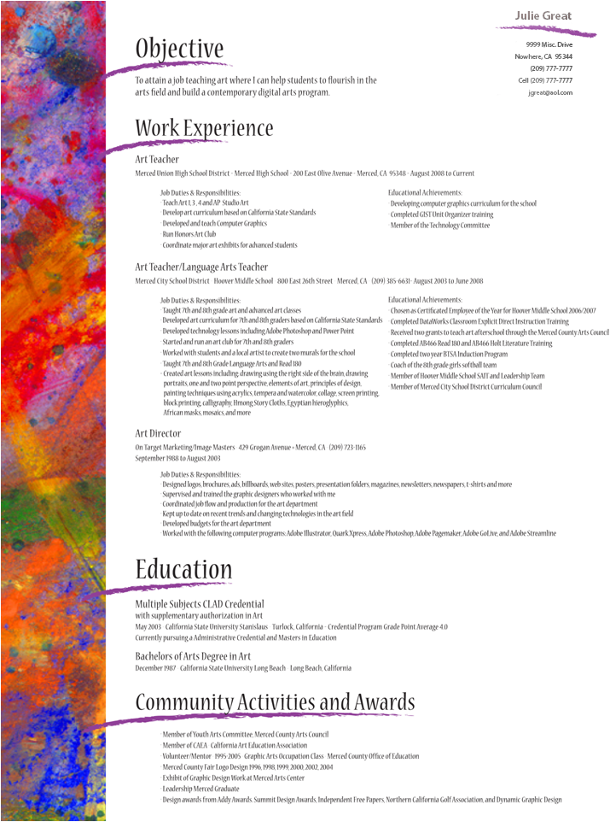
Or…designing your resume to match the field you are applying for. Like this one aimed at a job in the arts.

Slide 21
Examples of Creative Resumes

Slide 22
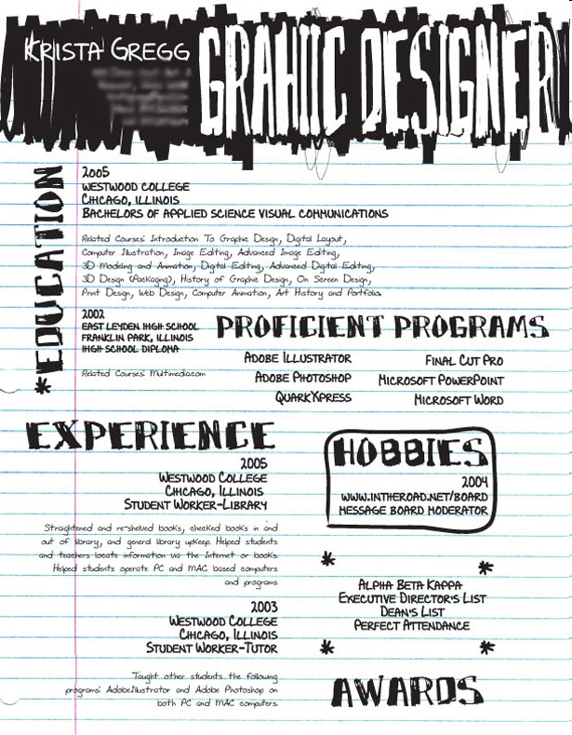

Slide 23
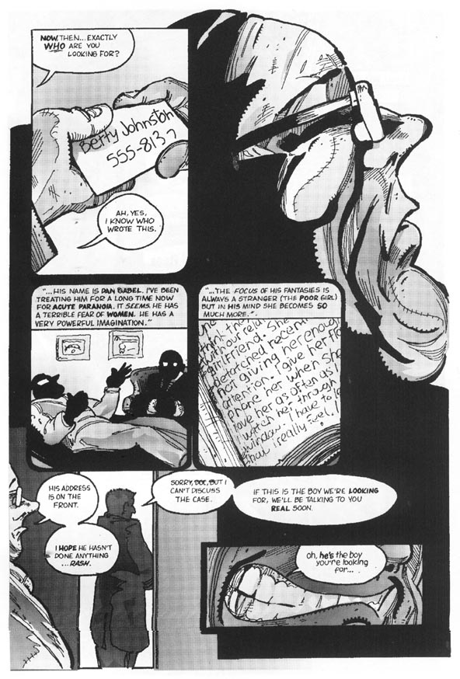

Slide 24
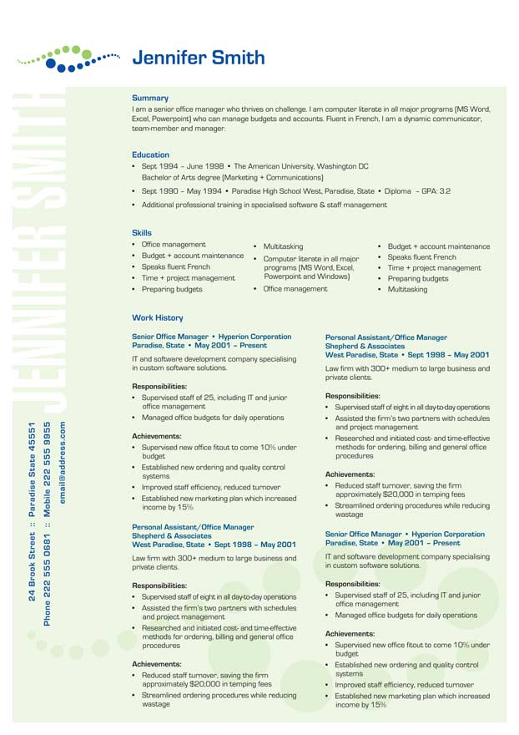

Slide 25
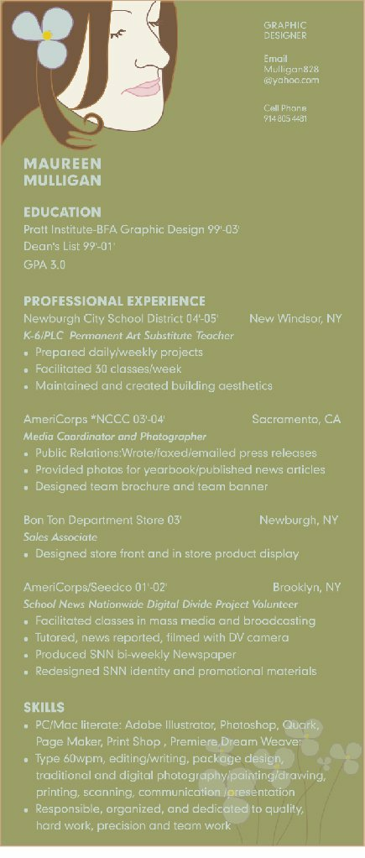

Slide 26
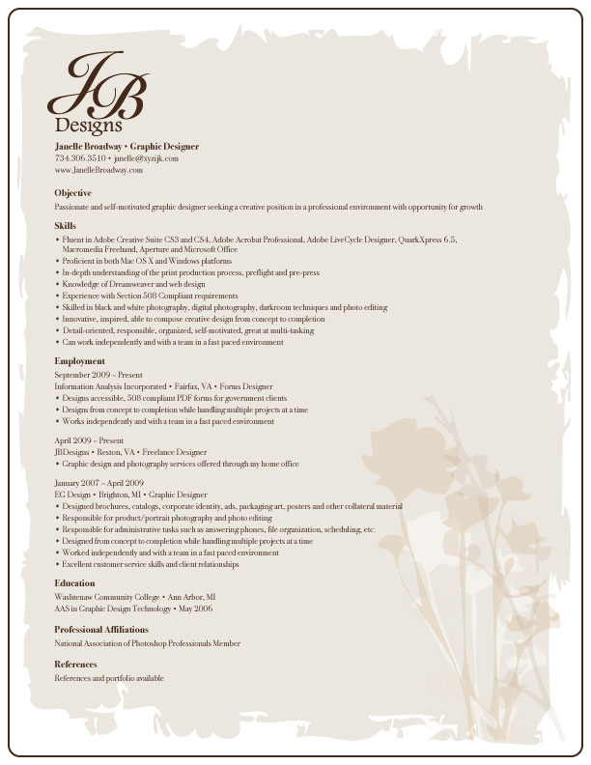

Slide 27
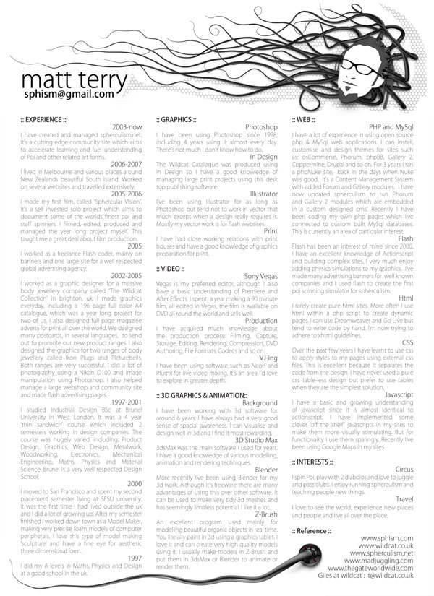

Slide 28
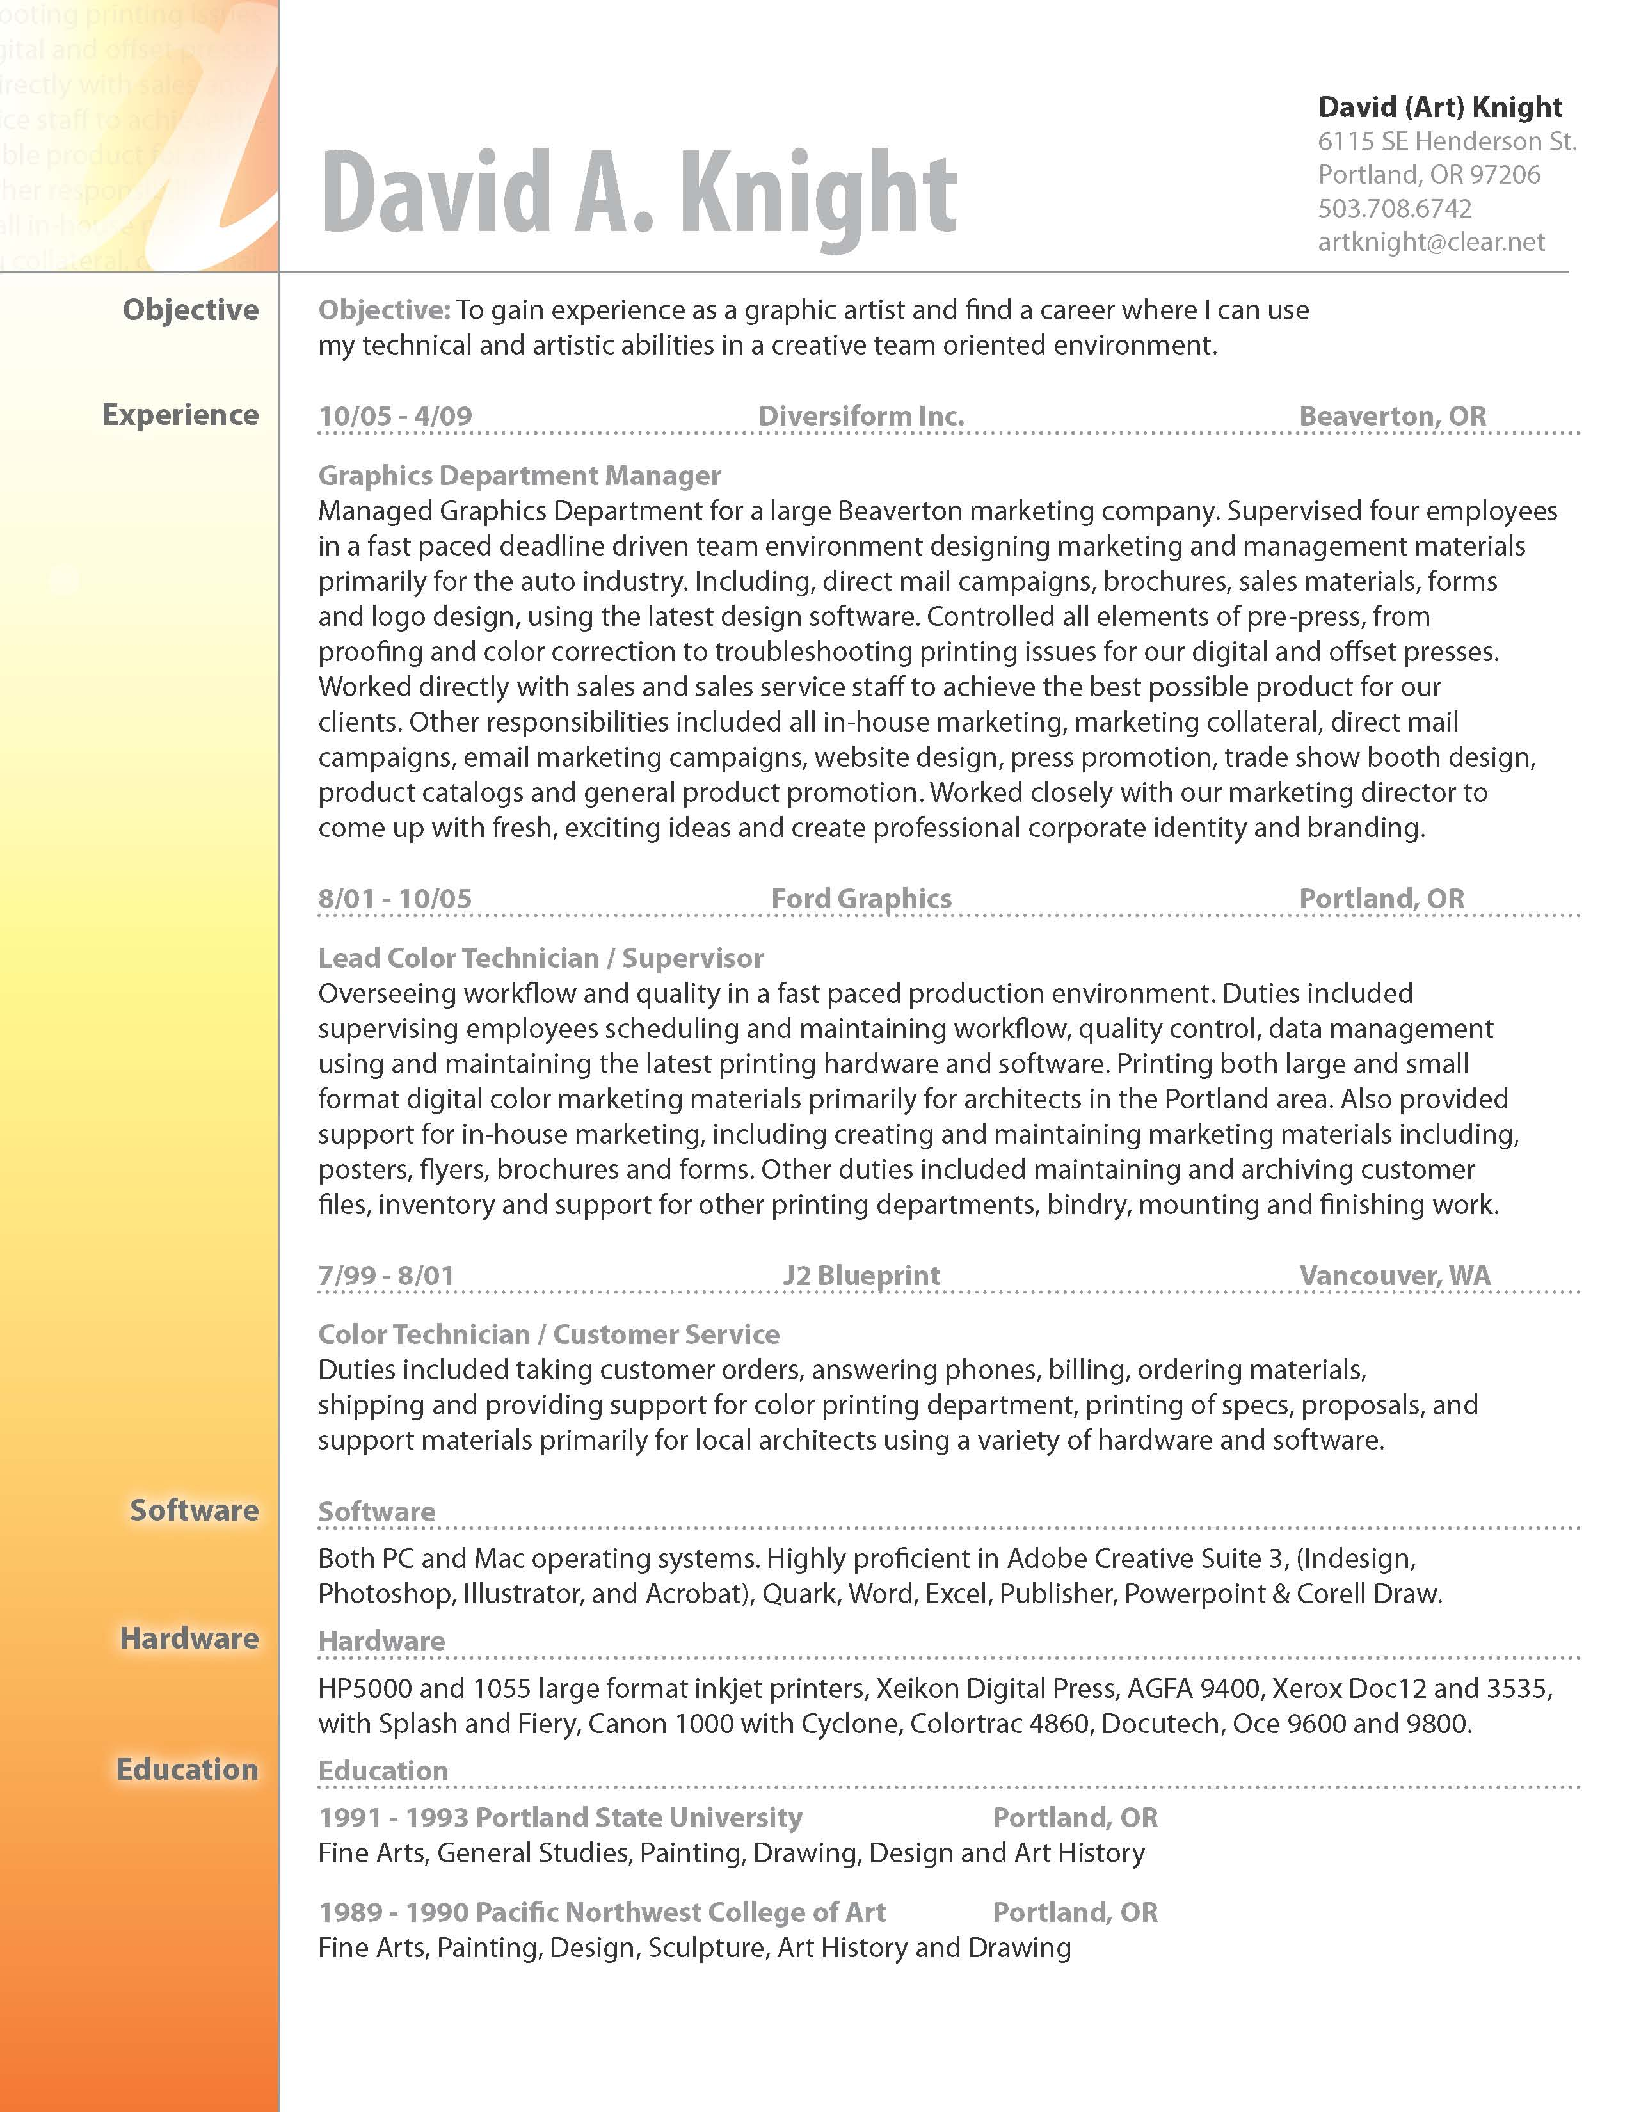

Slide 29
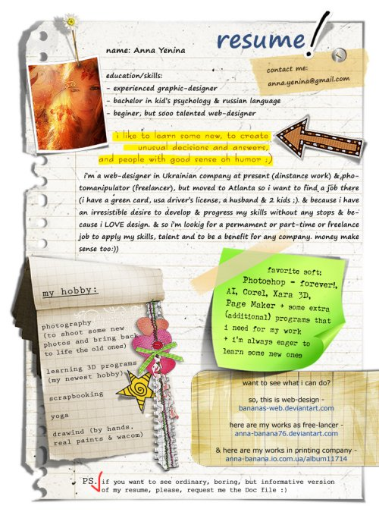
http://www.hongkiat.com/blog/creative-designer-resume-curriculum-vitae/

Slide 30
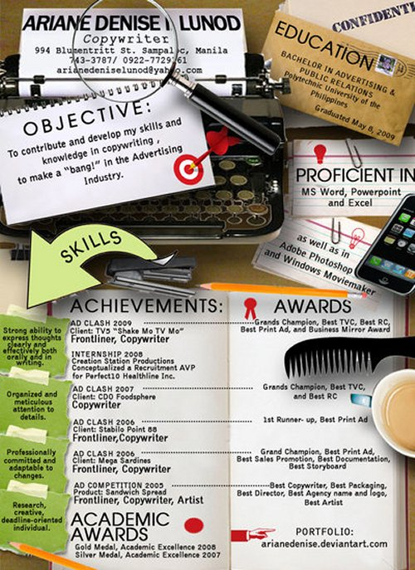
http://www.hongkiat.com/blog/creative-designer-resume-curriculum-vitae/

Slide 31
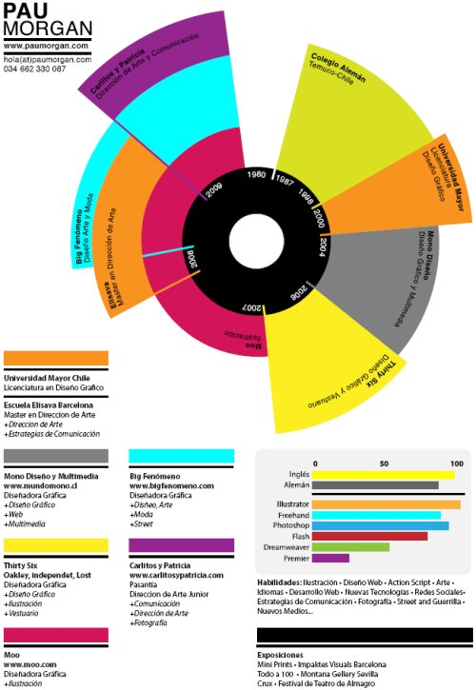
http://www.hongkiat.com/blog/creative-designer-resume-curriculum-vitae/

Slide 32
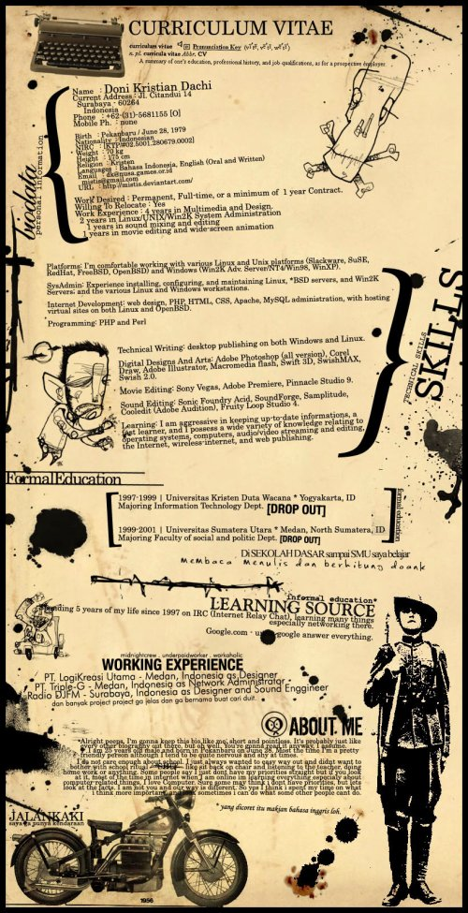
http://www.hongkiat.com/blog/creative-designer-resume-curriculum-vitae/

Slide 33
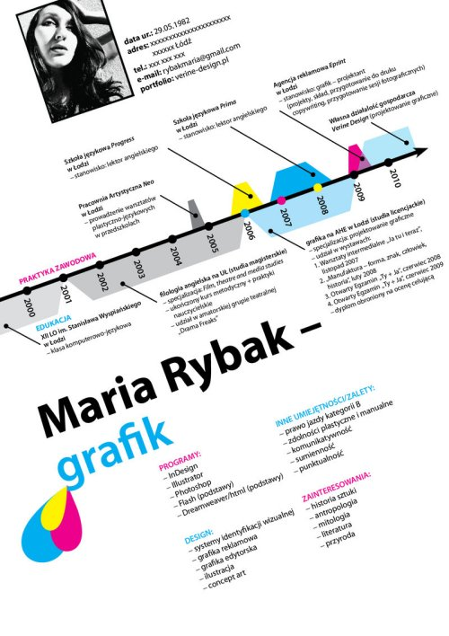
http://www.hongkiat.com/blog/creative-designer-resume-curriculum-vitae/

Slide 34
http://www.hongkiat.com/blog/creative-designer-resume-curriculum-vitae/

Slide 35
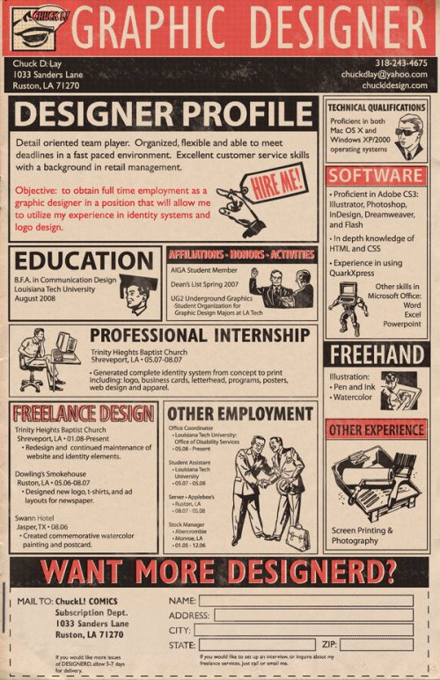
http://www.hongkiat.com/blog/creative-designer-resume-curriculum-vitae/

Slide 36
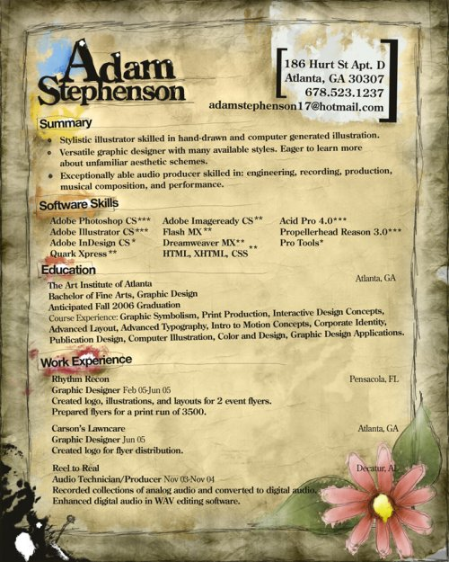
http://www.hongkiat.com/blog/creative-designer-resume-curriculum-vitae/

Slide 37
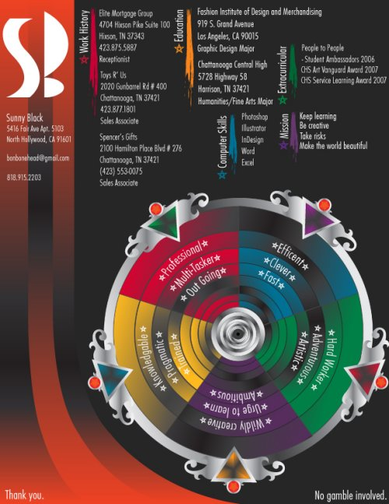
http://www.hongkiat.com/blog/creative-designer-resume-curriculum-vitae/

Slide 38
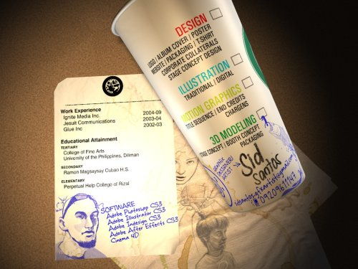
http://www.hongkiat.com/blog/creative-designer-resume-curriculum-vitae/

Slide 39
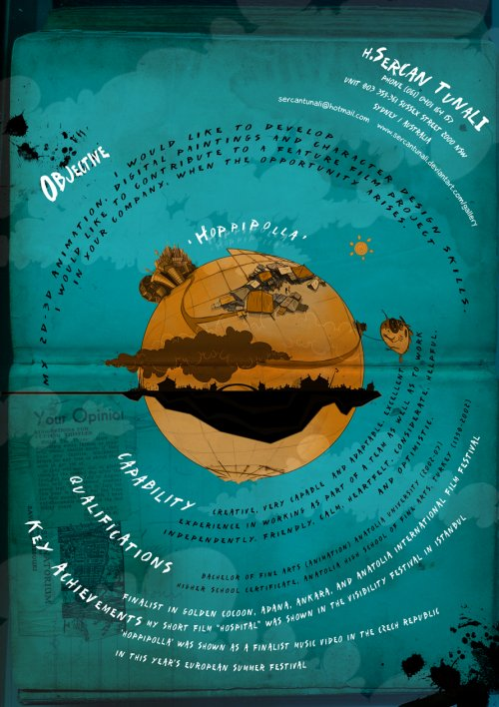
http://www.hongkiat.com/blog/creative-designer-resume-curriculum-vitae/

Slide 40
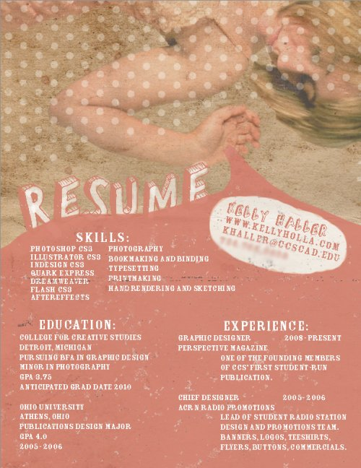
http://www.hongkiat.com/blog/creative-designer-resume-curriculum-vitae/

Slide 41
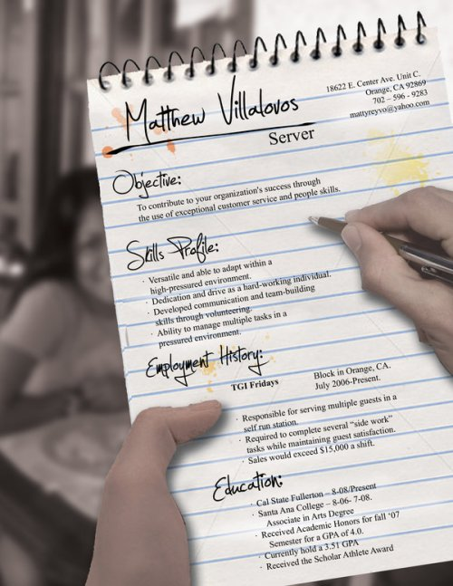
http://www.hongkiat.com/blog/creative-designer-resume-curriculum-vitae/

Slide 42
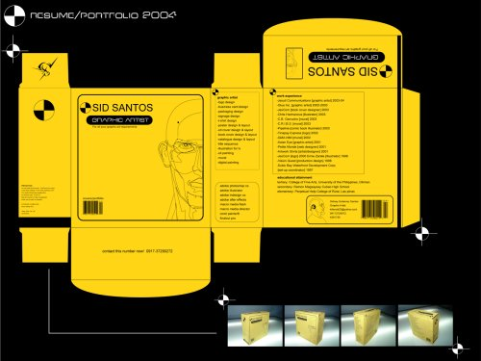
http://www.hongkiat.com/blog/creative-designer-resume-curriculum-vitae/

Slide 43
http://www.hongkiat.com/blog/creative-designer-resume-curriculum-vitae/

Slide 44
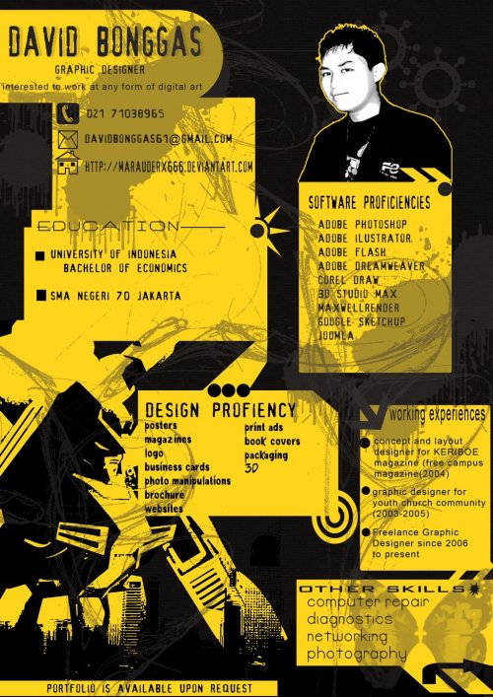
http://www.hongkiat.com/blog/creative-designer-resume-curriculum-vitae/

Slide 45
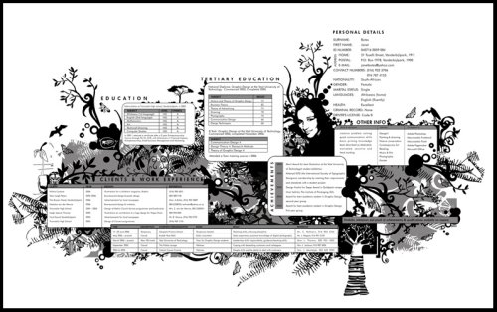
http://www.hongkiat.com/blog/creative-designer-resume-curriculum-vitae/

Slide 46
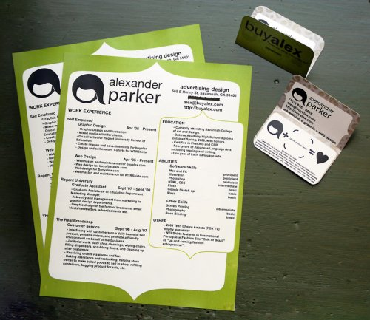
http://www.hongkiat.com/blog/creative-designer-resume-curriculum-vitae/

